Slide 1
Data: The data presented provides information about a client with potential credit fraud
https://www.kaggle.com/datasets/mishra5001/credit-card/data?select=application_data.csv
https://www.kaggle.com/datasets/mishra5001/credit-card/data?select=columns_description.csv
Notes:
Theses are the links that all data calculations and references were based on

Slide 2
Variable Descriptions:
TARGET: client with reported payment difficulties (this variable will represent credit fraud if
positive)
CODE_GENDER: Gender of the client
AMT_INCOME_TOTAL: Income of the client
AMT_CREDIT: Credit amount of the loan
NAME_CLIENT_TYPE: Was the client old or new when applying for the previous application
Notes:
The dataset used in this analysis is sourced from Kaggle and contains information about clients with potential credit fraud.
It comprises 122 variables, a mix of binomial and categorical, and was last updated four years ago.

Slide 3
Research Question for Data Analysis:
Are females at a higher risk of defaulting on loans? Does Gender have an effect on the likelihood of defaulting when controlling for their total income, credit loans, and client status for credit applications.
Notes:
Our exploration aims to answer: are females at a higher risk of defaulting on loans?
Moreover, we investigate whether gender significantly influences the likelihood of defaulting when controlling for other key factors.

Slide 4
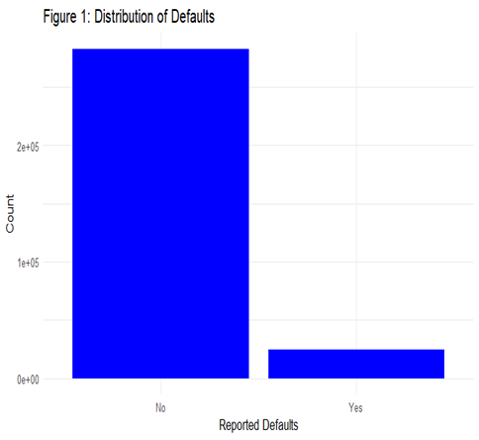
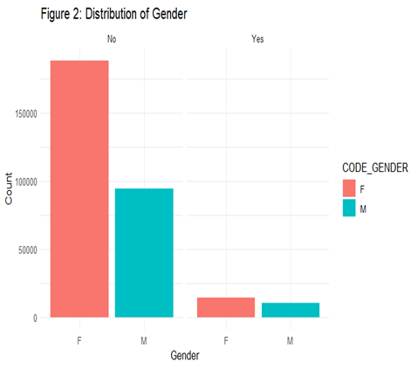
Notes:
Based upon Figure 1(top left) , most of the data collected shows that the vast majority of responses in Target are negative for default detection.
This means that most of the clients, based upon the data, collected may not be subject to defaulting and that further analysis utilizing Target will be a good response variable viable.
Next, we graph the distribution of Gender (male or female) to observe the split between genders collected and reported defaults. Based upon Figure 2(bottom right) , we can say that about twice the amount of clients reported to be females versus males had no reported default. However, from further observation, we can see that females have a slightly higher count than males for reported default.
For the continuing graphs please note that we created a variable to better reference the expected desired results. In our R code we created the variable TargetYes to verify all future factorizations of Target are the same.

Slide 5
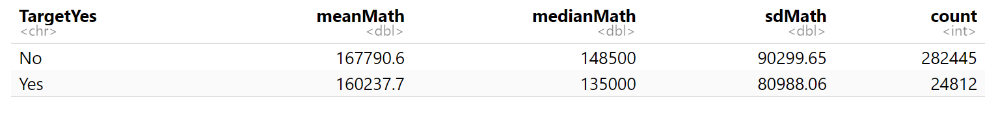
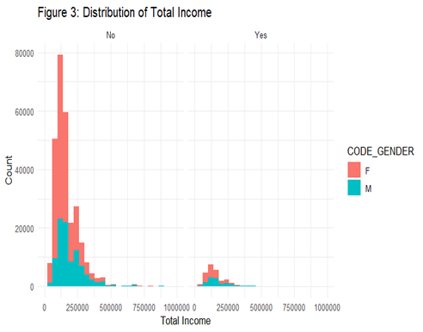
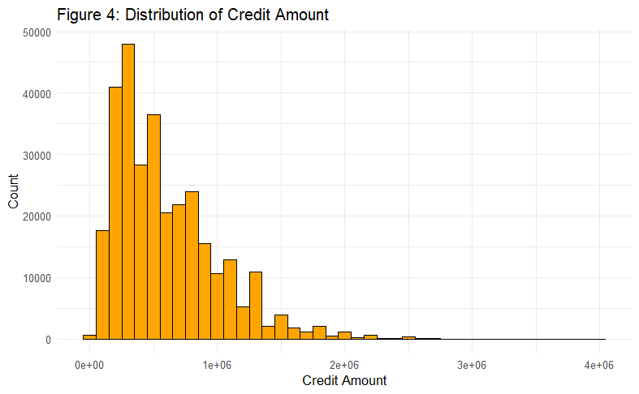
Notes:
Figure 3, the graph on the left shows the total income. We had some large outliers, which didn’t make sense. They may have been entered incorrectly or some other type of error. We decided to remove these.
Removing any data exceeding an income of 1,000,000 would keep our data from having errors or excessive outliers. We will set a maximum income value of 1,000,000 to clean our data.
As can be seen in Figure 3(on the left), the data comparing total income and the amount of defaults reported by gender, we can see that females typically show a pattern of having more reported defaults than males do; however, females also appear to have more data overall, so this graph alone is not enough to provide enough evidence to support our research statement.
It is interesting to note that figure 3 has a bit of a bimodal distribution.
We can also observe that the distribution of total income by sex are both right skewed and follow similar distributions amongst the X and Y axis.
Comparing the graphs for Total Income(Figure 3) and Credit amount(Figure 4), the graphs seem to be very similar.

Slide 6
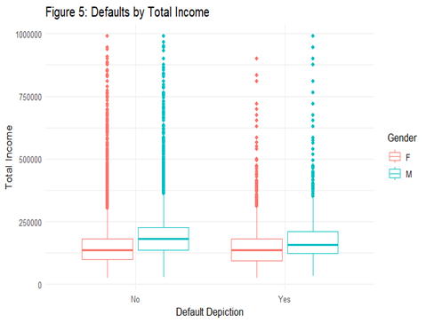
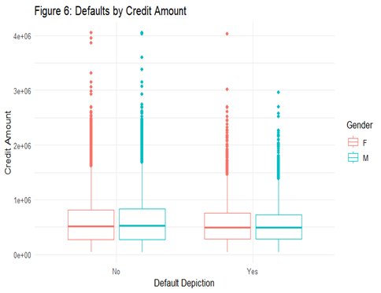
Notes:
Upon further analysis, we have found that males have higher income on average in each respective quarterly, as can be seen in Figure 5(top left).
Income doesn't appear to be a very strong predictor for determining if a client defaulted or not. The data doesn’t appear to be very different upon comparing total income and credit amount (between males and females regarding if they have reported default or not).
Credit amount may not be a strong predictor for determining if a client defaulted or not. This could be because the credit amount given is not sex-dependent, so males and females receive credit at the same rate based on their income.

Slide 7
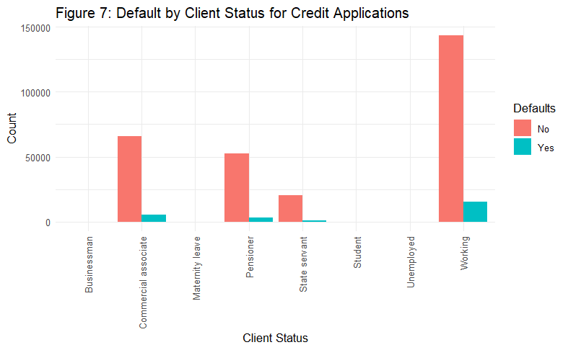

Slide 8
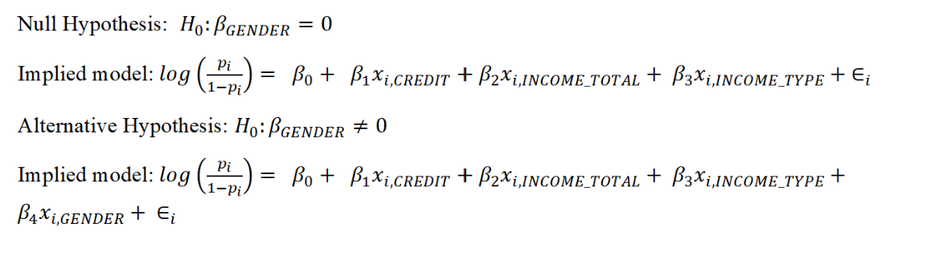
Hypothesis Test
Notes:
Two logistic regression models were employed in the statistical analysis: the full model and the reduced model.
The full model included predictors such as total income (AMT_INCOME_TOTAL), credit amount (AMT_CREDIT), income type (NAME_INCOME_TYPE), and gender (CODE_GENDERM).
The reduced model excluded the gender variable, encompassing total income, credit amount, and income type as predictors.

Slide 9
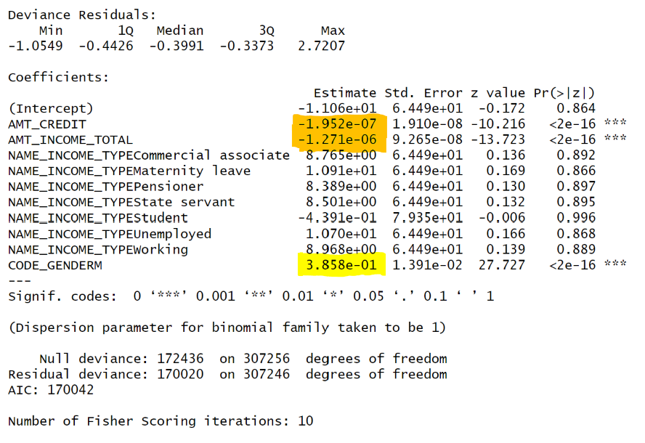
What are our findings?
Notes:
Moving on to model interpretation, the logistic regression output revealed insightful parameter estimates.
The coefficient for gender (CODE_GENDERM) was 0.3868 with a standard error of 0.01391. This positive coefficient indicates that being male is associated with an increase in the log odds of credit default. The other predictors, such as total income (AMT_INCOME_TOTAL) and credit amount (AMT_CREDIT), demonstrated negative coefficients, suggesting a negative relationship with the log odds of default.
These interpretations align with our expectations: higher income and credit amounts are associated with a lower likelihood of credit defaults.
In conclusion, the final logistic regression model, incorporating gender alongside other key predictors, emerges as a robust framework for predicting credit fraud.
The variables selected proved to be significant contributors, with gender playing a noteworthy role. Therefore, we can assert that, when controlling for total income, credit amount, and income type, gender remains a crucial factor in determining the likelihood of credit defaults.
This analysis contributes valuable insights to the ongoing discourse on credit risk assessment, emphasizing the need to consider gender dynamics in predicting and managing credit fraud.

Slide 10
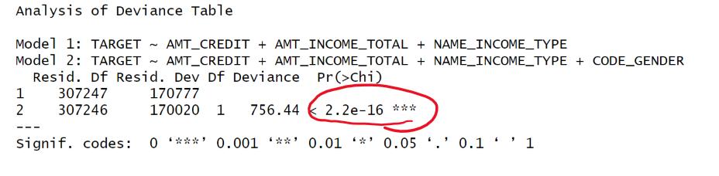
Notes:
The drop-in-deviance test was employed to assess the contribution of the gender variable and a value of 756.44 was calculated. Along with its p-value of < 2.2e-16 there was compelling evidence to reject the null hypothesis.
This rejection affirmed the importance of gender in predicting credit defaults and we will use the model with the variable for gender.
Additionally, the backward selection method confirmed the significance of all predictors in the model, further reinforcing the comprehensive nature of the chosen variables.

Slide 11

Confidence Interval
Notes:
Looking at our model, we can see that the gender being male is positive. This means that the gender being female is a negative predictor. A negative predictor lowers our Target value, which represents the likelihood of a client defaulting or not. If someone is female, they have a lower likelihood of defaulting on a payment.
We are 95% confidence that for CODE_GENDERM (Male), the defaults will increase by between 1.431200 and 1.511436, assuming all other variables are controlled in this model. Males have a greater odds of defaulting compared to females.

